Slide 1
UNIT-2
HBASE

Slide 2
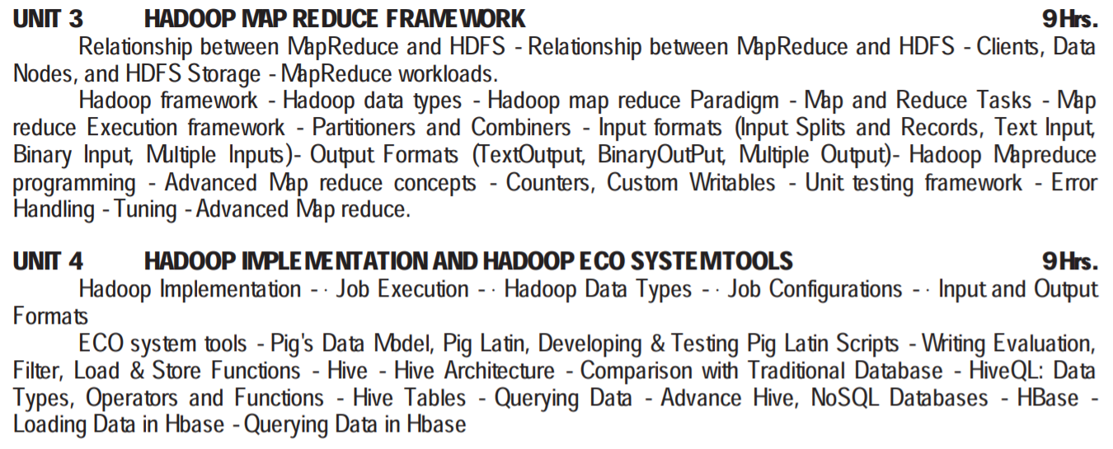

Slide 3
Applications such as HBase, Cassandra, couchDB, Dynamo, and MongoDB are some of the databases that store huge amounts of data and access the data in a random manner. DATABASE- BASED ON DATA HBASE- BASED ON HADOOP
Hadoop Random Access Databases

Slide 4
What is HBase?
HBase is a distributed column-oriented database built on top of the Hadoop file system. It is an open-source project and is horizontally scalable.
HBase is a data model that is similar to Google’s big table designed to provide quick random access to huge amounts of structured data. It leverages the fault tolerance provided by the Hadoop File System (HDFS).

Slide 5
It is a part of the Hadoop ecosystem that provides random real-time read/write access to data in the Hadoop File System.
One can store the data in HDFS either directly or through HBase. Data consumer reads/accesses the data in HDFS randomly using HBase. HBase sits on top of the Hadoop File System and provides read and write access.

Slide 6
HDFS | HBase
HDFS is a distributed file system suitable for storing large files. | HBase is a database built on top of the HDFS.
HDFS does not support fast individual record lookups. | HBase provides fast lookups for larger tables.
It provides high latency batch processing; no concept of batch processing. | It provides low latency access to single rows from billions of records (Random access).
It provides only sequential access of data. | HBase internally uses Hash tables and provides random access, and it stores the data in indexed HDFS files for faster lookups.

Slide 7
Storage Mechanism in HBase
HBase is a column-oriented database and the tables in it are sorted by row.
The table schema defines only column families, which are the key value pairs.
A table have multiple column families and each column family can have any number of columns.

Slide 8
HBASE
· Table is a collection of rows.
· Row is a collection of column families.
· Column family is a collection of columns.
· Column is a collection of key value pairs.

Slide 9
EXample
Rowid | Column Family |  |  | Column Family |  |  | Column Family |  |  | Column Family
 | col1 | col2 | col3 | col1 | col2 | col3 | col1 | col2 | col3 | col1 | col2 | col3
1
2
3

Slide 10
Column Oriented and Row Oriented
Column-oriented databases are those that store data tables as sections of columns of data, rather than as rows of data. Shortly, they will have column families.

Slide 11
Row-Oriented Database
It is suitable for Online Transaction Process (OLTP).
Such databases are designed for small number of rows and columns.
Column-Oriented Database
It is suitable for Online Analytical Processing (OLAP).
Column-oriented databases are designed for huge tables.

Slide 12
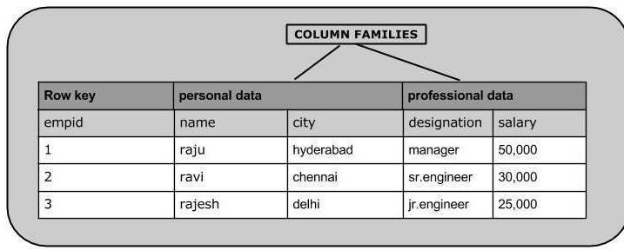
column families in a column-oriented database

Slide 13
Features of HBase
· HBase is linearly scalable.
· It has automatic failure support.
· It provides consistent read and writes.
· It integrates with Hadoop, both as a source and a destination.
· It has easy java API for client.
· It provides data replication across clusters.

Slide 14
Where to Use HBase
· Apache HBase is used to have random, real-time read/write access to Big Data.
· It hosts very large tables on top of clusters of commodity hardware.
· Apache HBase is a non-relational database modeled after Google's Bigtable. Bigtable acts up on Google File System, likewise Apache HBase works on top of Hadoop and HDFS.

Slide 15
Applications of HBase
· It is used whenever there is a need to write heavy applications.
· HBase is used whenever we need to provide fast random access to available data.
· Companies such as Facebook, Twitter, Yahoo, and Adobe use HBase internally.

Slide 16
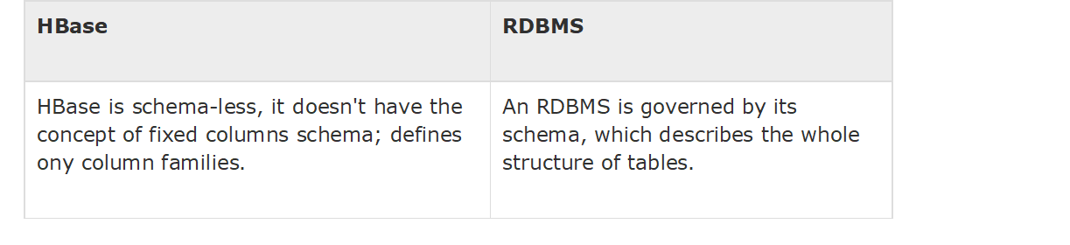
HBASE ,RDBMS DIFFERENCE

Slide 17
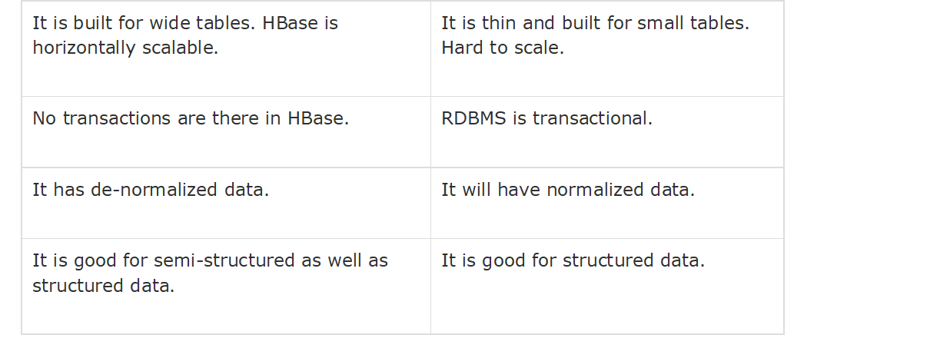

Slide 18
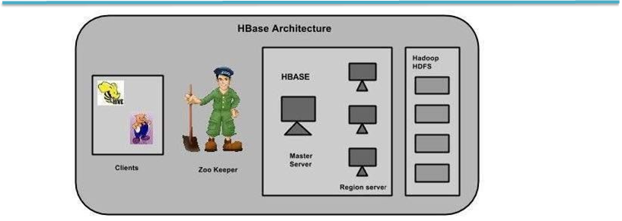
HBASE ARCHITECTURE

Slide 19
HBase has three major components: the client library, a master server, and region servers. Region servers can be added or removed as per requirement.

Slide 20
MasterServer
The master server - Assigns regions to the region servers and takes the help of Apache ZooKeeper for this task.
Handles load balancing of the regions across region servers. It unloads the busy servers and shifts the regions to less occupied servers.
Maintains the state of the cluster by negotiating the load balancing.
I

Slide 21
it Is responsible for schema changes and other metadata operations such as creation of tables and column families.
Regions
Regions are nothing but tables that are split up and spread across the region servers.

Slide 22
Region server
The region servers have regions that -
· Communicate with the client and handle data-related operations.
· Handle read and write requests for all the regions under it.
· Decide the size of the region by following the region size thresholds.

Slide 23
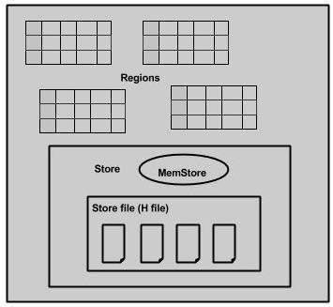
Region server-regions and stores

Slide 24
The store contains memory store and HFiles. Memstore is just like a cache memory.
Anything that is entered into the HBase is stored here initially. Later, the data is transferred and saved in Hfiles as blocks and the memstore is flushed.

Slide 25
Zookeeper
Zookeeper is an open-source project that provides services like maintaining configuration information, naming, providing distributed synchronization, etc.
· Master servers use these nodes to discover available servers.
·

Slide 26
Zookeeper·
In addition to availability, the nodes are also used to track server failures or network partitions.
· Clients communicate with region servers via zookeeper.
· In pseudo and standalone modes, HBase itself will take care of zookeeper.

Slide 27
Loading Data in HBase & Querying Data in Hbase.
HBase - Create Data:
Inserting Data using HBase Shell
This topic demonstrates how to create data in an HBase table. To create data in an HBase table, the following commands and methods are used:

Slide 28
· P ut command,
· add() method of Put class, and
· put() method of HTable class.

Slide 29
As an example, we are going to create the following table in HBase.

Slide 30
put ’<table name>’,’row1’,’<colfamily:colname>’,’<value>’

Slide 31
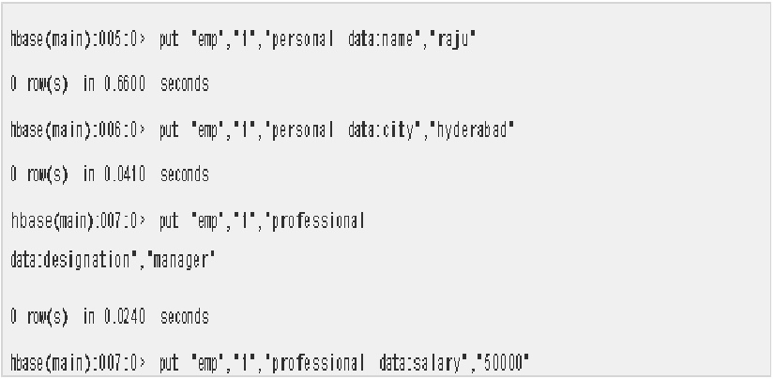

Slide 32
Insert the remaining rows using the put command in the same way. If you insert the whole table, you will get the following output.

Slide 33
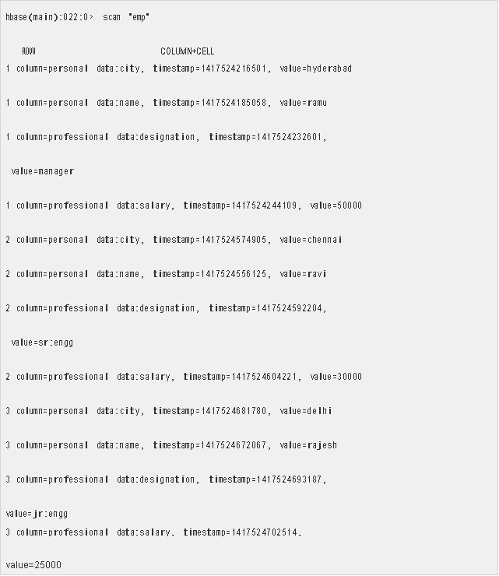

Slide 34
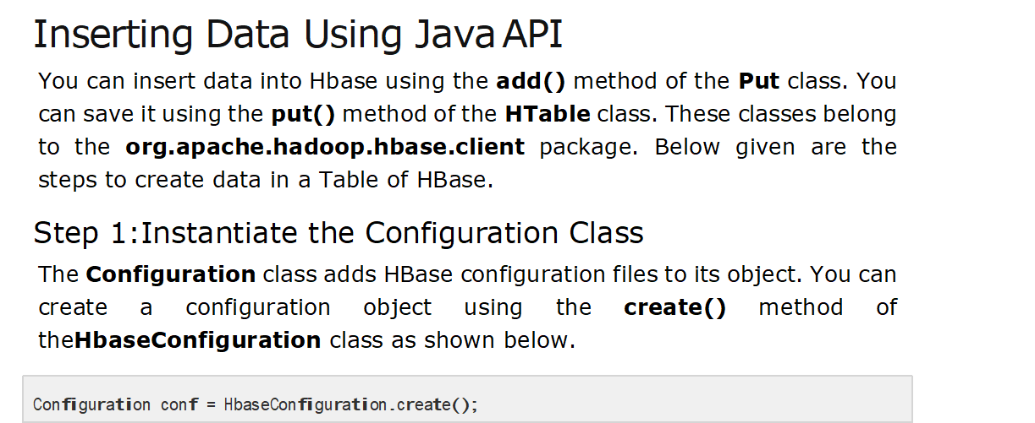

Slide 35
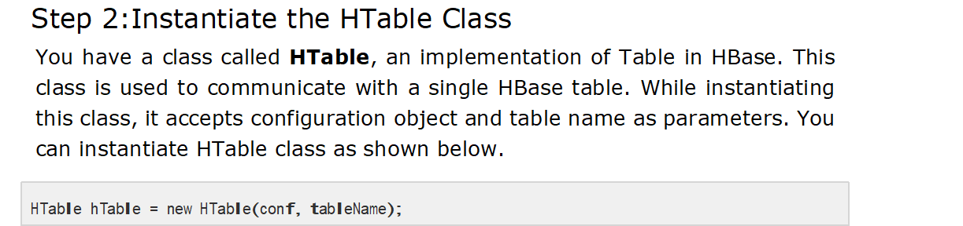

Slide 36
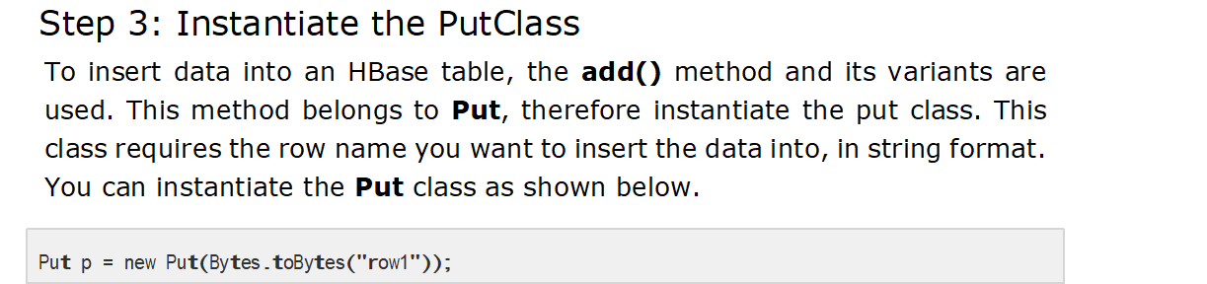

Slide 37
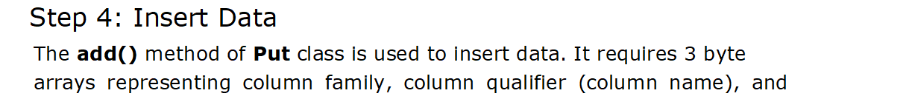

Slide 38
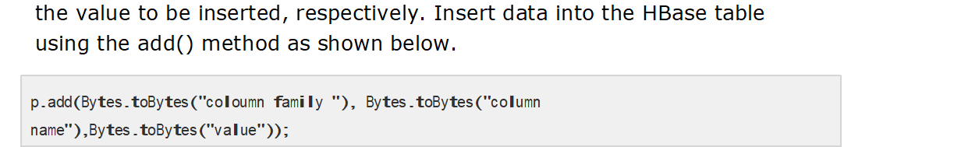

Slide 39
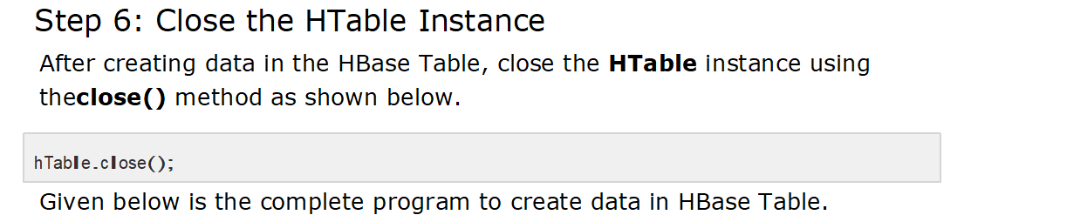

Slide 40
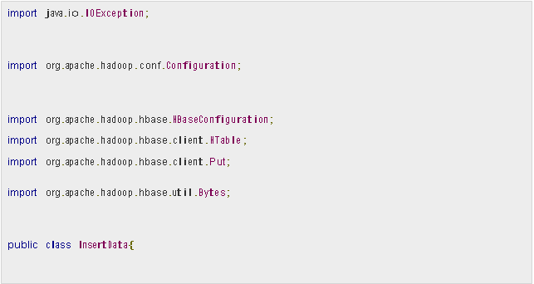

Slide 41
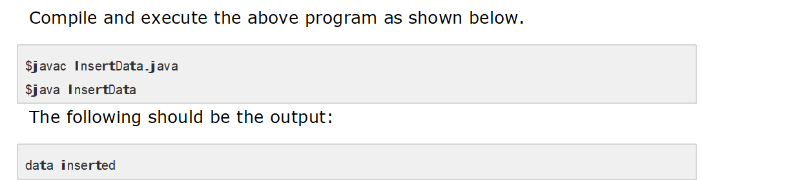

Slide 42
Reading Data using HBase Shell
The get command and the get() method of HTable class are used to read data from a table in HBase. Using get command, you can get a single row of data at a time. Its syntax is as follows:
get ’<table name>’,’row1’

Slide 43
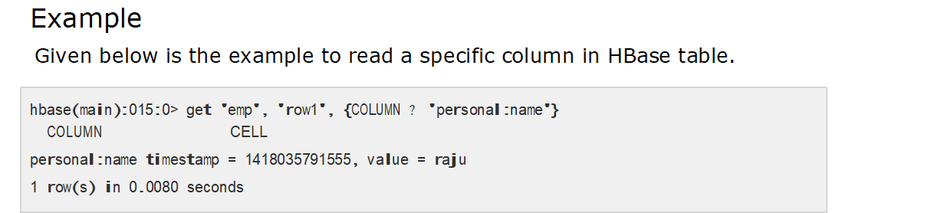
Reading a Specific Column
Given below is the syntax to read a specific column using the get method.

Slide 44
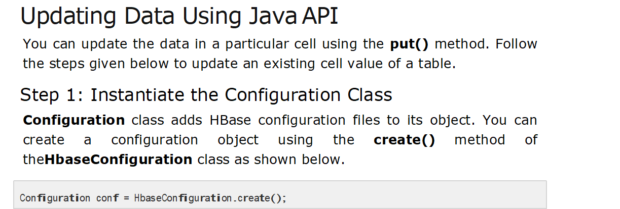

Slide 45
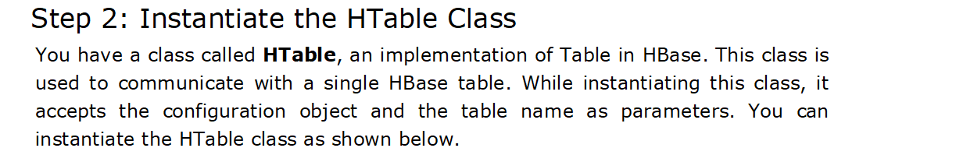
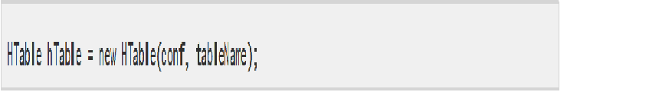

Slide 46
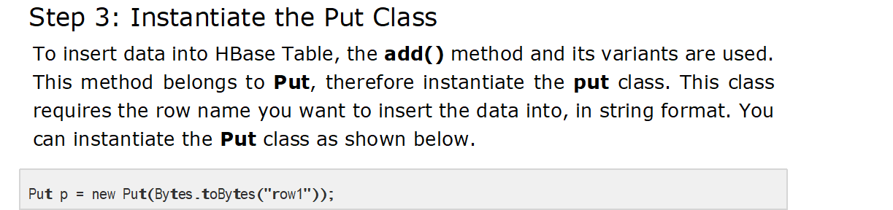

Slide 47
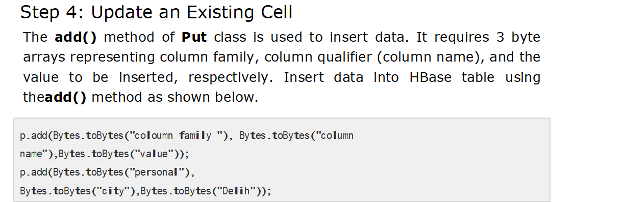

Slide 48
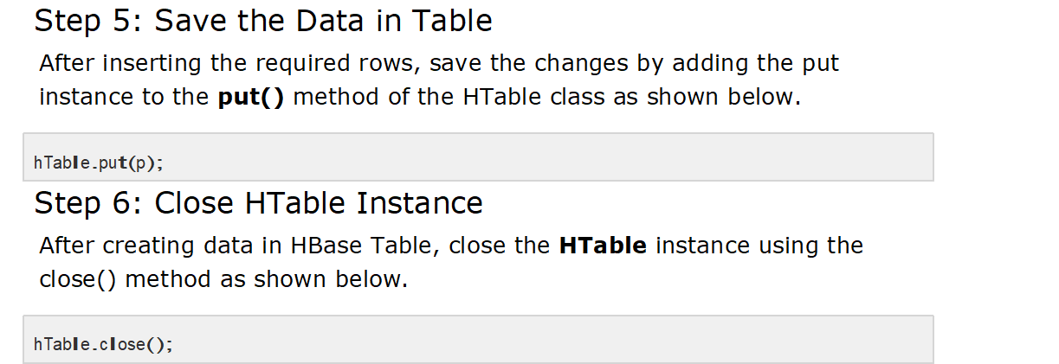

Slide 49
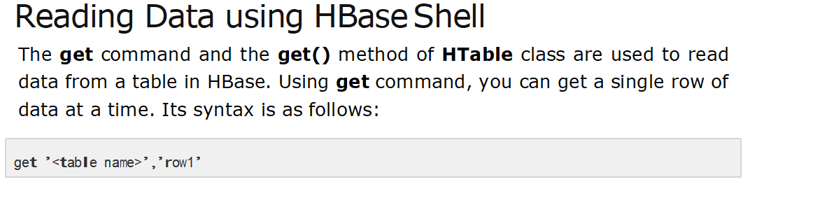

Slide 50
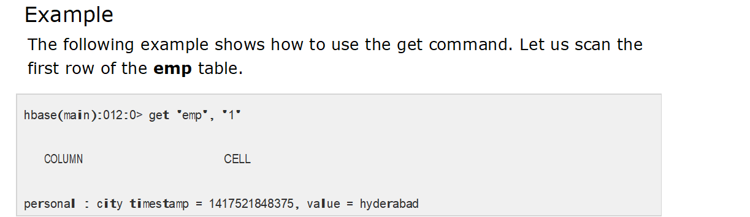

Slide 51
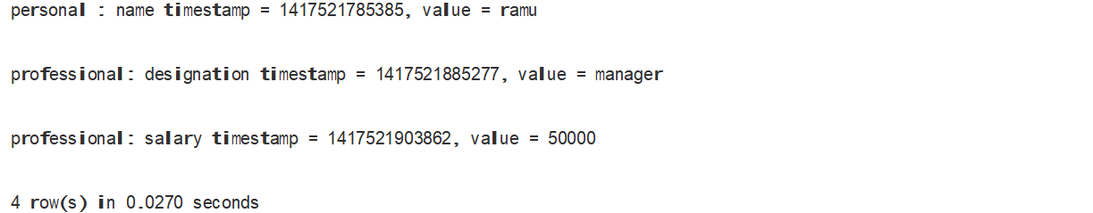

Slide 52
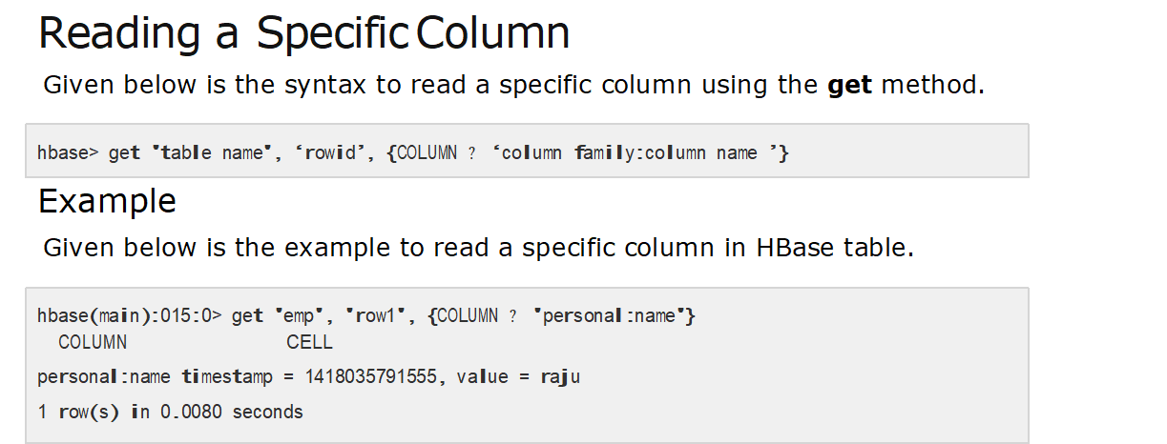

Slide 53
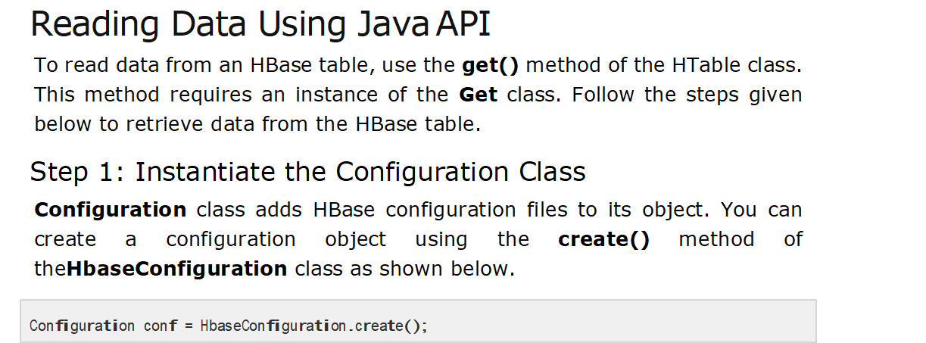

Slide 54
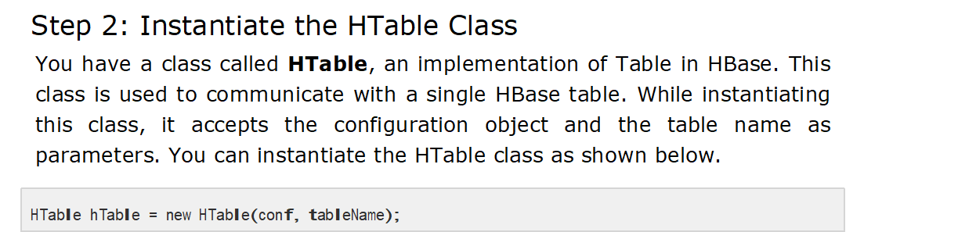

Slide 55
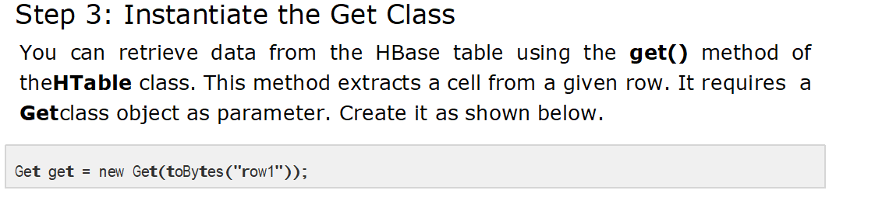

Slide 56
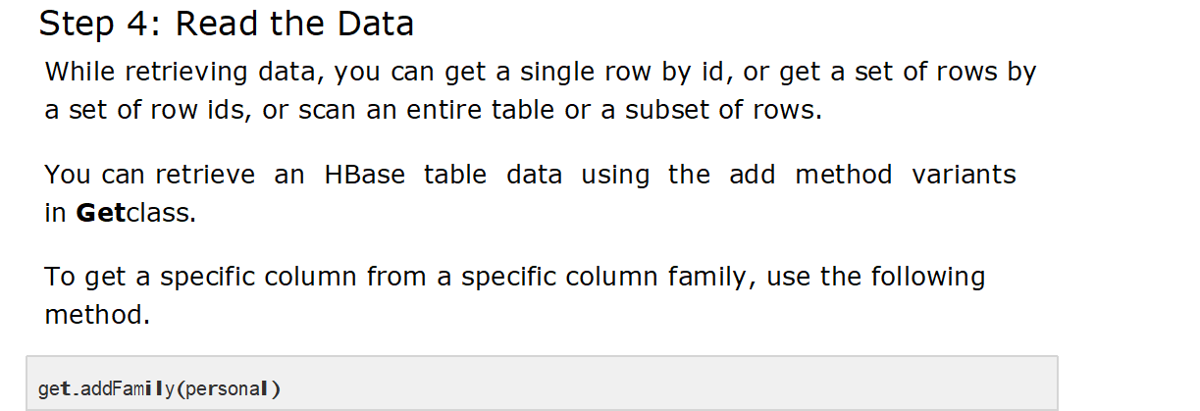

Slide 57
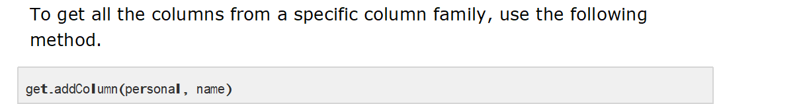

Slide 58
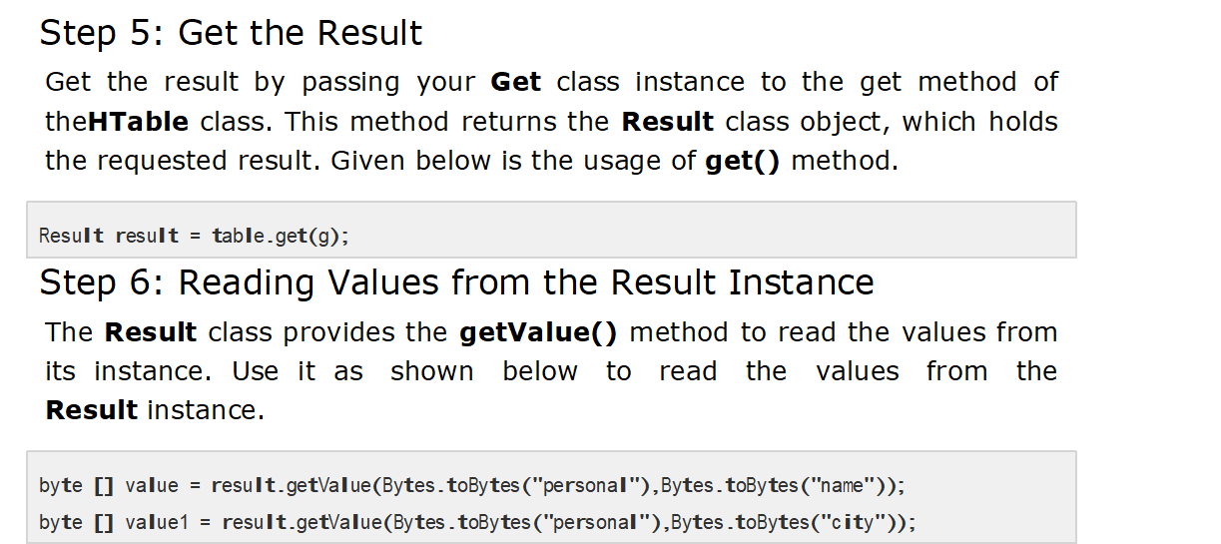

Slide 59
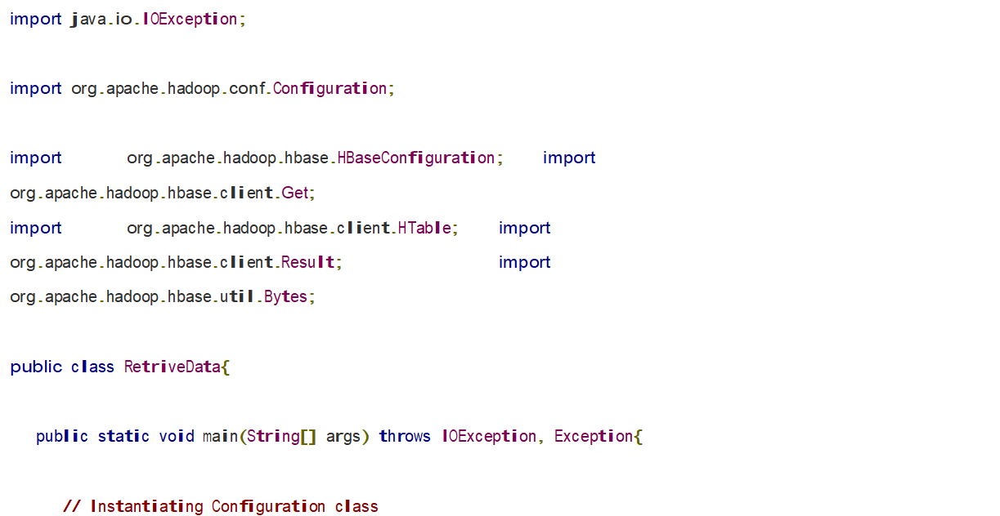

Slide 60
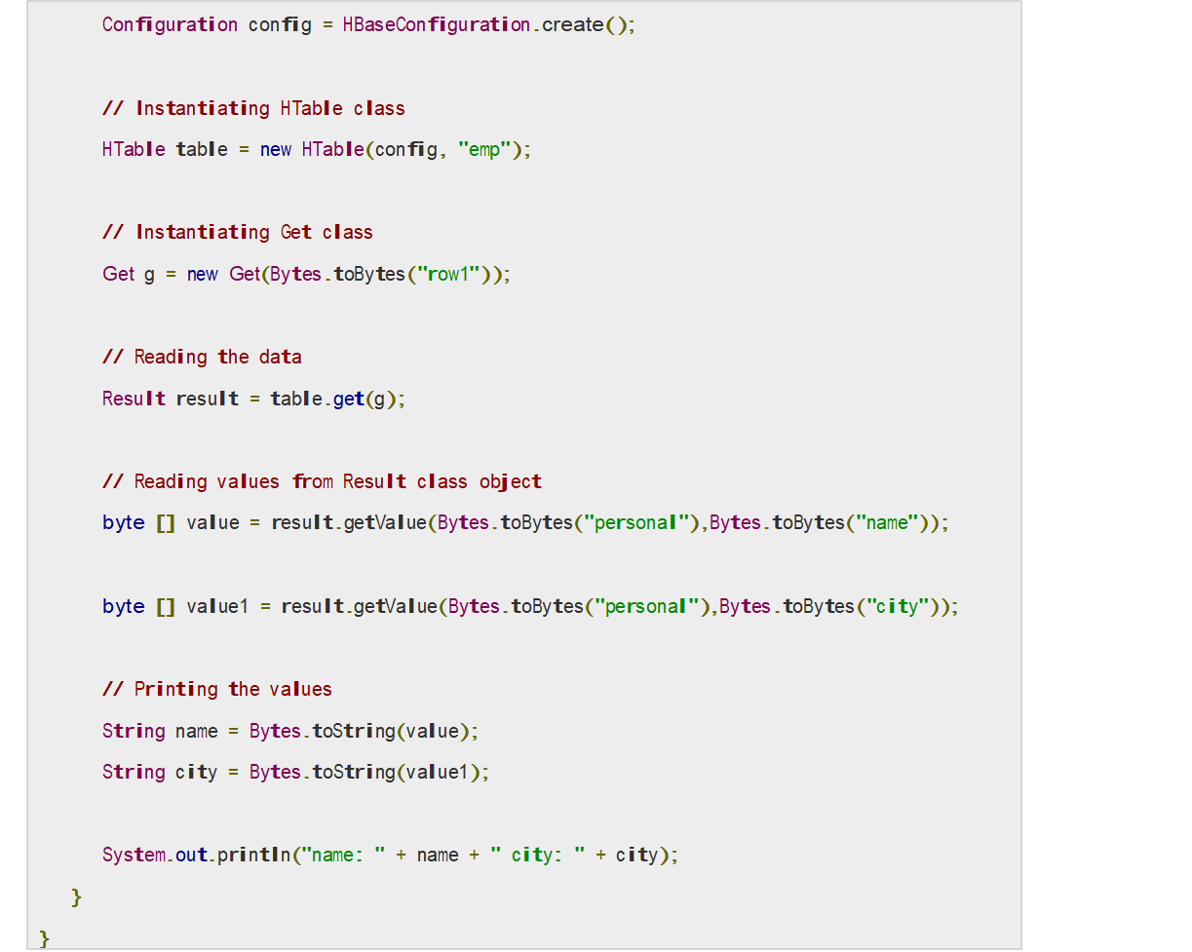

Slide 61
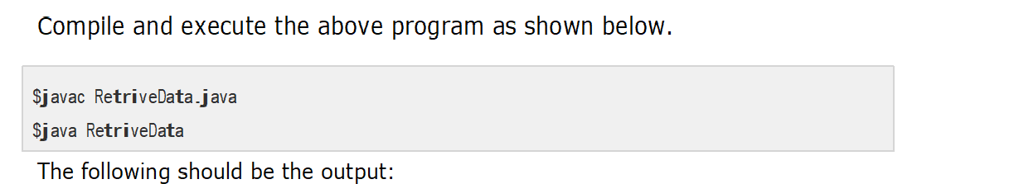
city

Slide 62
city: Delhi

Slide 63
Thank you

